Slide 1
HTML 5

Slide 2
What is HTML?
HTML is the standard markup language for creating Web pages.
HTML stands for Hyper Text Markup Language
HTML describes the structure of Web pages using markup
HTML elements are the building blocks of HTML pages
HTML elements are represented by tags
HTML tags label pieces of content such as "heading", "paragraph", "table", and so on
Browsers do not display the HTML tags, but use them to render the content of the page

Slide 3
A Simple HTML Document
<!DOCTYPE html> <html> <head> <title>Page Title</title> </head> <body> <h1>My First Heading</h1> <p>My first paragraph.</p> </body> </html>

Slide 4
Example Explained
The <!DOCTYPE html> declaration defines this document to be HTML5
The <html> element is the root element of an HTML page
The <head> element contains meta information about the document
The <title> element specifies a title for the document
The <body> element contains the visible page content
The <h1> element defines a large heading
The <p> element defines a paragraph

Slide 5
HTML Tags
HTML tags are element names surrounded by angle brackets:
<tagname>content goes here...</tagname>
HTML tags normally come in pairs like <p> and </p>
The first tag in a pair is the start tag, the second tag is the end tag
The end tag is written like the start tag, but with a forward slash inserted before the tag name
The start tag is also called the opening tag, and the end tag the closing tag.

Slide 6
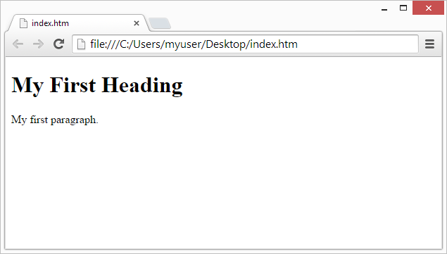
Web Browsers
The purpose of a web browser (Chrome, IE, Firefox, Safari) is to read HTML documents and display them.
The browser does not display the HTML tags, but uses them to determine how to display the document:

Slide 7
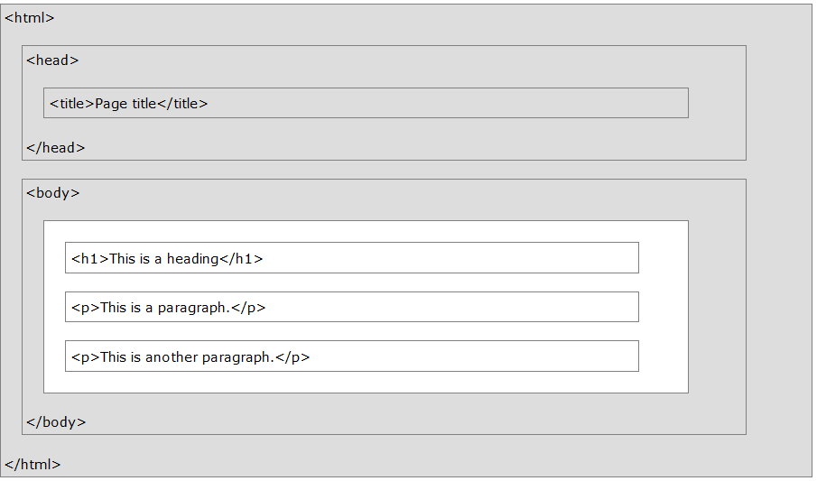
HTML Page Structure

Slide 8
The <!DOCTYPE> Declaration
The <!DOCTYPE> declaration represents the document type, and helps browsers to display web pages correctly.
It must only appear once, at the top of the page (before any HTML tags).
The <!DOCTYPE> declaration is not case sensitive.
The <!DOCTYPE> declaration for HTML5 is:
<!DOCTYPE html>

Slide 9
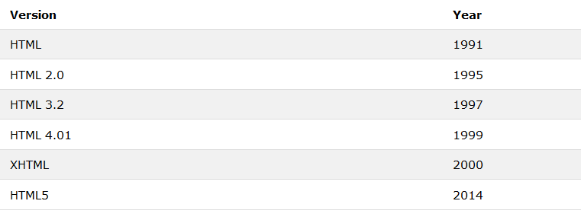
HTML Versions

Slide 10
HTML Editors
https://blog.templatetoaster.com/best-free-html-editors/

Slide 11
HTML Editors
Visual Studio Code
https://code.visualstudio.com/

Slide 12
Step 1: Open Notepad (PC)
Windows 8 or later:
Open the Start Screen (the window symbol at the bottom left on your screen). Type Notepad.
Windows 7 or earlier:
Open Start > Programs > Accessories > Notepad
Step 1: Open TextEdit (Mac)
Open Finder > Applications > TextEdit
Also change some preferences to get the application to save files correctly. In Preferences > Format > choose "Plain Text"
Then under "Open and Save", check the box that says "Display HTML files as HTML code instead of formatted text".
Then open a new document to place the code

Slide 13
Step 2: Write Some HTML
<!DOCTYPE html> <html> <body> <h1>My First Heading</h1> <p>My first paragraph.</p> </body> </html>

Slide 14
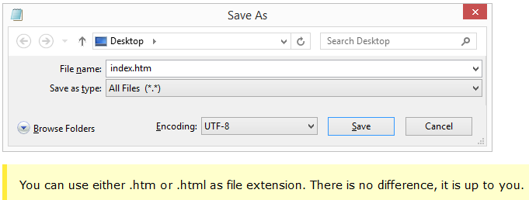
Step 3: Save the HTML Page
Save the file on your computer. Select File > Save as in the Notepad menu.
Name the file "index.htm" and set the encoding to UTF-8 (which is the preferred encoding for HTML files).

Slide 15
Step 4: View the HTML Page in Your Browser

Slide 16
Headings
<!DOCTYPE html>
<html>
<body>
<h1>This is heading 1</h1>
<h2>This is heading 2</h2>
<h3>This is heading 3</h3>
<h4>This is heading 4</h4>
<h5>This is heading 5</h5>
<h6>This is heading 6</h6>
</body>
</html>

Slide 17
Paragraph
<!DOCTYPE html>
<html>
<body>
<p>This is a paragraph.</p>
<p>This is another paragraph.</p>
</body>
</html>

Slide 18
Link
<!DOCTYPE html>
<html>
<body>
<h2>HTML Links</h2>
<p>HTML links are defined with the a tag:</p>
<a href="https://developer.mozilla.org/en-US/">This is a link</a>
</body>
</html>

Slide 19
Empty HTML Elements
HTML elements with no content are called empty elements.
<br> is an empty element without a closing tag (the <br> tag defines a line break)
<!DOCTYPE html>
<html>
<body>
<p>This is a <br> paragraph with a line break.</p>
</body>
</html>

Slide 20
HTML Attributes
All HTML elements can have attributes
Attributes provide additional information about an element
Attributes are always specified in the start tag
Attributes usually come in name/value pairs like: name="value"
Ex The href Attribute
HTML links are defined with the <a> tag. The link address is specified in the href attribute:

Slide 21
<!DOCTYPE html>
<html>
<body>
<a href="https://https://www.google.com/">This is a search engine</a>
</body>
</html>

Slide 22
The src Attribute
HTML images are defined with the <img> tag.
The filename of the image source is specified in the src attribute:
The width and height Attributes
Images in HTML have a set of size attributes, which specifies the width and height of the image:

Slide 23
<!DOCTYPE html>
<html>
<body>
<h2>The src Attribute</h2>
<p>HTML images are defined with the img tag, and the filename of the image source is specified in the src attribute:</p>
<img src="photo.jpeg" width="500" height="600"> </body>
</html>

Slide 24
The style Attribute
The style attribute is used to specify the styling of an element, like color, font, size etc.
<!DOCTYPE html>
<html>
<body>
<h2>The style Attribute</h2>
<p>The style attribute is used to specify the styling of an element, like color:</p>
<p style="color:red">I am a paragraph.</p>
</body>
</html>

Slide 25
The Lang Attribute
The language of the document can be declared in the <html> tag.
The language is declared with the lang attribute.
Declaring a language is important for accessibility applications (screen readers) and search engines:

Slide 26
DOCTYPE html>
<html lang "es">
<body>
<p>This sentence is in English.</p>
<p lang="en-GB">This sentence will be read with a British accent</p>
<p lang="es">Esta frase es en espa&ntilde;ol.</p> (Spanish)</p>
<p lang="fr">Cette phrase est en fran&ccedil;ais</p> (French)
<p lang="cy">Mae’r frawddeg hon yng Nghymraeg.</p>
(Welsh)</p>
</body>
</html>

Slide 27
Good Practice
Always use lowercase attribute names
Always quote attribute values with double quotes
In some situations, when the attribute value itself contains double quotes, it is necessary to use single quotes
<p title =‘Maria “Army Lady" Hamilton‘>
<p title=" Maria ' Army Lady ' Hamilton“>

Slide 28
HTML Headings
Headings are defined with the <h1> to <h6> tags.
<h1> defines the most important heading. <h6> defines the least important heading.
<!DOCTYPE html>
<html>
<body>
<h1>Heading 1</h1>
<h2>Heading 2</h2>
<h3>Heading 3</h3>
<h4>Heading 4</h4>
<h5>Heading 5</h5>
<h6>Heading 6</h6>
</body>
</html>

Slide 29
Each HTML heading has a default size. However, you can specify the size for any heading with the style attribute, using the CSS font-size property:
<!DOCTYPE html>
<html>
<body>
<h1 style="font-size:60px;">Heading 1</h1>
<p>You can change the size of a heading with the style attribute, using the font-size property.</p>
</body>
</html>

Slide 30
HTML Horizontal Rules
The <hr> tag defines a thematic break in an HTML page, and is most often displayed as a horizontal rule.
The <hr> element is used to separate content (or define a change) in an HTML page:

Slide 31
<!DOCTYPE html>
<html>
<body>
<h1>This is heading 1</h1>
<p>This is some text.</p>
<hr>
<h2>This is heading 2</h2>
<p>This is some other text.</p>
<hr>
<h3>This is heading 3</h3>
<p>This is some other text.</p>
</body>
</html>

Slide 32
The HTML <head> Element
The HTML <head> element has nothing to do with HTML headings.
The <head> element is a container for metadata. HTML metadata is data about the HTML document. Metadata is not displayed.
The <head> element is placed between the <html> tag and the <body> tag:

Slide 33
<!DOCTYPE html>
<html>
<head>
<title>My First HTML</title>
<meta charset="UTF-8">
</head>
<body>
<p>The HTML head element contains meta data.</p>
<p>Meta data is data about the HTML document.</p>
</body>
</html>
-------Metadata typically define the document title, character set, styles, links, scripts, and other meta information

Slide 34
How to View HTML Source?
Have you ever seen a Web page and wondered "Hey! How did they do that?"
View HTML Source Code:
Right-click in an HTML page and select "View Page Source" (in Chrome) or "View Source" (in IE), or similar in other browsers. This will open a window containing the HTML source code of the page.
Inspect an HTML Element:
Right-click on an element (or a blank area), and choose "Inspect" or "Inspect Element" to see what elements are made up of (you will see both the HTML and the CSS). You can also edit the HTML or CSS on-the-fly in the Elements or Styles panel that opens

Slide 35
Activity
Mark up the text with appropriate tags:
“ATC NewZealand Limited" is the most important heading.
“Hamilton Garden" is the next most important heading.
“Student" is the third most important heading.
The last sentence is just a paragraph.
Melt warning: this product is made with ingredients that allow it to soften around body temperature. During hot spells, it may melt. If you have any concerns please contact Customer Care.
Start with the most important heading (the largest) and end with the least important heading (the smallest).

Slide 36
Research
History of HTML

Slide 37
HTML Display
You cannot be sure how HTML will be displayed.
Large or small screens, and resized windows will create different results.
With HTML, you cannot change the output by adding extra spaces or extra lines in your HTML code.
The browser will remove any extra spaces and extra lines when the page is displayed:

Slide 38
<!DOCTYPE html> <html> <body> <p> This paragraph contains a lot of lines in the source code, but the browser ignores it. </p> <p> This paragraph contains a lot of spaces in the source code, but the browser ignores it. </p> <p> The number of lines in a paragraph depends on the size of the browser window. If you resize the browser window, the number of lines in this paragraph will change. </p> </body> </html>

Slide 39
The HTML <pre> Element
The HTML <pre> element defines preformatted text.
The text inside a <pre> element is displayed in a fixed-width font (usually Courier), and it preserves both spaces and line breaks:

Slide 40
<!DOCTYPE html> <html> <body> <p>The pre tag preserves both spaces and line breaks:</p> <pre> My Bonnie lies over the ocean. My Bonnie lies over the sea. My Bonnie lies over the ocean. Oh, bring back my Bonnie to me. </pre> </body> </html>

Slide 41
HTML Styles
I am Red
I am Blue
I am Big

Slide 42
<!DOCTYPE html> <html> <body> <p>I am normal</p> <p style="color:red;">I am red</p> <p style="color:blue;">I am blue</p> <p style="font-size:50px;">I am big</p> </body> </html>

Slide 43
The HTML Style Attribute
<tagname style="property:value;">

Slide 44
HTML Background Color
<!DOCTYPE html>
<html>
<body style="background-color:powderblue;">
<h1>This is a heading</h1>
<p>This is a paragraph.</p>
</body>
</html>

Slide 45
HTML Text Color
<!DOCTYPE html>
<html>
<body>
<h1 style="color:blue;">This is a heading</h1>
<p style="color:red;">This is a paragraph.</p>
</body>
</html>

Slide 46
HTML Fonts
<!DOCTYPE html>
<html>
<body>
<h1 style="font-family:verdana;">This is a heading</h1>
<p style="font-family:courier;">This is a paragraph.</p>
</body>
</html>

Slide 47
HTML Text Size
<!DOCTYPE html>
<html>
<body>
<h1 style="font-size:300%;">This is a heading</h1>
<p style="font-size:160%;">This is a paragraph.</p>
</body>
</html>

Slide 48
HTML Text Alignment
<!DOCTYPE html>
<html>
<body>
<h1 style="text-align:center;">Centered Heading</h1>
<p style="text-align:left;">Centered paragraph.</p>
<p style="text-align:right;">Centered paragraph.</p>
</body>
</html>

Slide 49
HTML Text Formatting
This text is bold
This text is italic
This is _{subscript} and ^{superscript}

Slide 50
<!DOCTYPE html>
<html>
<body>
<p><b>This text is bold</b></p>
<p><i>This text is italic</i></p>
<p>This is<sub> subscript</sub> and <sup>superscript</sup></p>
</body>
</html>

Slide 51
HTML Formatting Elements
<b> - Bold text
<strong> - Important text
<i> - Italic text
<em> - Emphasized text
<mark> - Marked text
<small> - Small text
<del> - Deleted text
<ins> - Inserted text
<sub> - Subscript text
<sup> - Superscript text

Slide 52
Practice Formatting elements

Slide 53
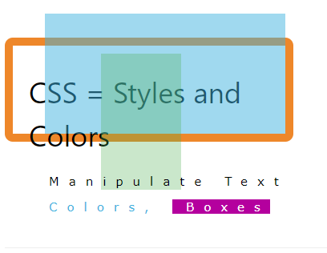

Slide 54
HTML Styles - CSS
CSS stands for Cascading Style Sheets.
CSS describes how HTML elements are to be displayed on screen, paper, or in other media.
CSS saves a lot of work. It can control the layout of multiple web pages all at once.
CSS can be added to HTML elements in 3 ways:
Inline - by using the style attribute in HTML elements
Internal - by using a <style> element in the <head> section
External - by using an external CSS file
The most common way to add CSS, is to keep the styles in separate CSS files. However, here we will use inline and internal styling, because this is easier to demonstrate, and easier for you to try it yourself.

Slide 55
Inline CSS
An inline CSS is used to apply a unique style to a single HTML element.
An inline CSS uses the style attribute of an HTML element.
This example sets the text color of the <h1> element to blue:
<h1 style="color:blue;">This is a Blue Heading</h1>

Slide 56
Internal CSS
An internal CSS is used to define a style for a single HTML page.
An internal CSS is defined in the <head> section of an HTML page, within a <style> element:

Slide 57
<!DOCTYPE html>
<html>
<head>
<style>
body {background-color: powderblue;}
h1 {color: blue;}
p {color: red;}
</style>
</head>
<body>
<h1>This is a heading</h1>
<p>This is a paragraph.</p>
</body>
</html>

Slide 58
An external style sheet is used to define the style for many HTML pages.
With an external style sheet, you can change the look of an entire web site, by changing one file!
To use an external style sheet, add a link to it in the <head> section of the HTML page:

Slide 59
<!DOCTYPE html>
<html>
<head>
<link rel="stylesheet" href="styles.css">
</head>
<body>
<h1>This is a heading</h1>
<p>This is a paragraph.</p>
</body>
</html>

Slide 60
body {
background-color: powderblue;
}
h1 {
color: blue;
}
p {
color: red;
}

Slide 61
CSS Border
<!DOCTYPE html>
<html>
<head>
<style>
p {
border: 1px solid powderblue;
}
</style>
</head>
<body>
<h1>This is a heading</h1>
<p>This is a paragraph.</p>
<p>This is a paragraph.</p>
<p>This is a paragraph.</p>
</body>
</html>

Slide 62
CSS Padding=(space) between the text and the border
<!DOCTYPE html>
<html>
<head>
<style>
p {
border: 1px solid powderblue;
padding: 30px;
}
</style>
</head>
<body>
<h1>This is a heading</h1>
<p>This is a paragraph.</p>
<p>This is a paragraph.</p>
<p>This is a paragraph.</p>
</body>
</html>

Slide 63
CSS Margin- (space) outside the border
<!DOCTYPE html>
<html>
<head>
<style>
p {
border: 1px solid powderblue;
margin: 50px;
}
</style>
</head>
<body>
<h1>This is a heading</h1>
<p>This is a paragraph.</p>
<p>This is a paragraph.</p>
<p>This is a paragraph.</p>
</body>
</html>

Slide 64
The id Attribute
To define a specific style for one special element, add an id attribute to the element
<!DOCTYPE html>
<html>
<head>
<style>
#p01 {
color: blue;
}
</style>
</head>
<body>
<p>This is a paragraph.</p>
<p>This is a paragraph.</p>
<p id="p01">I am different.</p>
</body>
</html>

Slide 65
The class Attribute
<!DOCTYPE html>
<html>
<head>
<style>
p.error {
color: red;
}
</style>
</head>
<body>
<p>This is a paragraph.</p>
<p>This is a paragraph.</p>
<p class="error">I am different.</p>
<p>This is a paragraph.</p>
<p class="error">I am different too.</p>
</body>
</html>

Slide 66
Recap
Use the HTML style attribute for inline styling
Use the HTML <style> element to define internal CSS
Use the HTML <link> element to refer to an external CSS file
Use the HTML <head> element to store <style> and <link> elements
Use the CSS color property for text colors
Use the CSS font-family property for text fonts
Use the CSS font-size property for text sizes
Use the CSS border property for borders
Use the CSS padding property for space inside the border
Use the CSS margin property for space outside the border

Slide 67
Link
HTML Link Colors
By default, a link will appear like this (in all browsers):
An unvisited link is underlined and blue
A visited link is underlined and purple
An active link is underlined and red
You can change the default colors, by using CSS:

Slide 68
Link
<!DOCTYPE html>
<html>
<head>
<style>
a:link {
color: green;
background-color: transparent;
text-decoration: none;
}
a:visited {
color: pink;
background-color: transparent;
text-decoration: none;
}
a:hover {
color: red;
background-color: transparent;
text-decoration: underline;
}
a:active {
color: yellow;
background-color: transparent;
text-decoration: underline;
}
</style>
</head>
<body>
<h2>Link Colors</h2>
<p>You can change the default colors of links</p>
<a href="https://www.facebook.com/images.asp" target="_blank">HTML Images</a>
</body>
</html>

Slide 69
The target attribute specifies where to open the linked document.
The target attribute can have one of the following values:
_blank - Opens the linked document in a new window or tab
_self - Opens the linked document in the same window/tab as it was clicked (this is default)
_top - Opens the linked document in the full body of the window

Slide 70
Images
<img src="html5.gif" alt="HTML5 Icon" width="128" height="128">
<img src="html5.gif" alt="HTML5 Icon" style="width:128px;height:128px;">

Slide 71
Images in Another Folder
<img src="/images/html5.gif" alt="HTML5 Icon" style="width:128px;height:128px;">
Images on Another Server
<img src="https://cdn.atwilltech.com/flowerdatabase/c/celebrate-the-day-fresh-flowers-VA01607.425.jpg" alt=“Red rose" style="width:104px;height:142px;">

Slide 72
Animated images
<img src="programming.gif" alt="Computer man" style="width:48px;height:48px;">
Image as an link
<a href="https://www.genesfloristmd.com/product/va01 607/celebrate-the-day">
<img src="smiley.gif" alt="Red Rose" style="width:42px;height:42px;border:0;">
</a>

Slide 73
Background image
<p style="background-image:url('d1.jpg')">Your Text</p>
Float
style="float:right;width:42px;height:42px;“

Slide 74
Table
An HTML table is defined with the <table> tag.
Each table row is defined with the <tr> tag.
A table header is defined with the <th> tag.
By default, table headings are bold and centered.
A table data/cell is defined with the <td> tag.

Slide 75
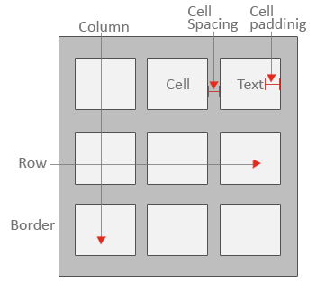

Slide 76
<!DOCTYPE html>
<html>
<body>
<h2>Basic HTML Table</h2>
<table style="width:100%">
<tr>
<th>Firstname</th>
<th>Lastname</th>
<th>Age</th>
</tr>
<tr>
<td>Jill</td>
<td>Smith</td>
<td>50</td>
</tr>
<tr>
<td>Eve</td>
<td>Jackson</td>
<td>94</td>
</tr>
<tr>
<td>John</td>
<td>Doe</td>
<td>80</td>
</tr>
</table>
</body>
</html>

Slide 77
Table border
table, th, td
{
border: 1px solid black;
}
table, th, td
{ border: 1px solid black; border-collapse: collapse; }

Slide 78
<!DOCTYPE html>
<html>
<head>
<style>
table, th, td {
border: 1px solid black;
}
</style>
</head>
<body>
<h2>Bordered Table</h2>
<p>Use the CSS border property to add a border to the table.</p>
<table style="width:100%">
<tr>
<th>Firstname</th>
<th>Lastname</th>
<th>Age</th>
</tr>
<tr>
<td>Jill</td>
<td>Smith</td>
<td>50</td>
</tr>
<tr>
<td>Eve</td>
<td>Jackson</td>
<td>94</td>
</tr>
<tr>
<td>John</td>
<td>Doe</td>
<td>80</td>
</tr>
</table>
</body>
</html>

Slide 79
<!DOCTYPE html>
<html>
<head>
<style>
table, th, td {
border: 1px solid black;
border-collapse: collapse;
}
</style>
</head>
<body>
<h2>Collapsed Borders</h2>
<p>If you want the borders to collapse into one border, add the CSS border-collapse property.</p>
<table style="width:100%">
<tr>
<th>Firstname</th>
<th>Lastname</th>
<th>Age</th>
</tr>
<tr>
<td>Jill</td>
<td>Smith</td>
<td>50</td>
</tr>
<tr>
<td>Eve</td>
<td>Jackson</td>
<td>94</td>
</tr>
<tr>
<td>John</td>
<td>Doe</td>
<td>80</td>
</tr>
</table>
</body>
</html>

Slide 80
HTML Table - Adding Cell Padding
Cell padding specifies the space between the cell content and its borders.
If you do not specify a padding, the table cells will be displayed without padding.
th, td
{ padding: 15px; }

Slide 81
<!DOCTYPE html>
<html>
<head>
<style>
table, th, td {
border: 1px solid black;
border-collapse: collapse;
}
th, td {
padding: 15px;
}
</style>
</head>
<body>
<h2>Cellpadding</h2>
<p>Cell padding specifies the space between the cell content and its borders.</p>
<table style="width:100%">
<tr>
<th>Firstname</th>
<th>Lastname</th>
<th>Age</th>
</tr>
<tr>
<td>Jill</td>
<td>Smith</td>
<td>50</td>
</tr>
<tr>
<td>Eve</td>
<td>Jackson</td>
<td>94</td>
</tr>
<tr>
<td>John</td>
<td>Doe</td>
<td>80</td>
</tr>
</table>
<p>Try to change the padding to 5px.</p>
</body>
</html>

Slide 82
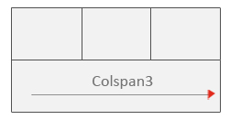
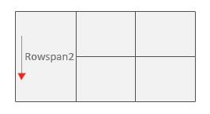
Colspan & Rowspan
HTML Table - Cells that Span Many Rows
HTML Table - Cells that Span Many Rows

Slide 83
<!DOCTYPE html>
<html>
<head>
<style>
table, th, td {
border: 1px solid black;
border-collapse: collapse;
}
th, td {
padding: 5px;
text-align: left;
}
</style>
</head>
<body>
<h2>Cell that spans two columns</h2>
<p>To make a cell span more than one column, use the colspan attribute.</p>
<table style="width:100%">
<tr>
<th>Name</th>
<th colspan="2">Telephone</th>
</tr>
<tr>
<td>Bill Gates</td>
<td>55577854</td>
<td>55577855</td>
</tr>
</table>
</body>
</html>

Slide 84
<!DOCTYPE html>
<html>
<head>
<style>
table, th, td {
border: 1px solid black;
border-collapse: collapse;
}
th, td {
padding: 5px;
text-align: left;
}
</style>
</head>
<body>
<h2>Cell that spans two rows</h2>
<p>To make a cell span more than one row, use the rowspan attribute.</p>
<table style="width:100%">
<tr>
<th>Name:</th>
<td>Bill Gates</td>
</tr>
<tr>
<th rowspan="2">Telephone:</th>
<td>55577854</td>
</tr>
<tr>
<td>55577855</td>
</tr>
</table>
</body>
</html>

Slide 85
HTML Table - Adding a Caption
After the <table> tag, <caption> tag should be the second tag.
In a HTML table we can use <caption> tag only once.
<table border="1" cellpadding="10">
<caption>Caption</caption>
<tr>
<th>Header</th><th>Header</th>
</tr>
<tr>
<td >Row 1 Cell 1</td>
<td>Row 1 Cell 2</td></tr>
</table>

Slide 86
A Special Style for One Table
To define a special style for a special table, add an id attable
Head
#t01 {
width: 100%;
background-color: #f1f1c1;
}
Body
table id="t01"

Slide 87
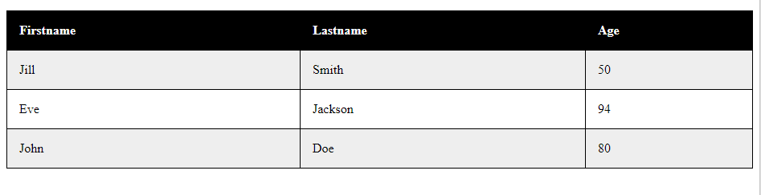
And add more styles
table#t01 tr:nth-child(even) {
background-color: #eee;
}
table#t01 tr:nth-child(odd) {
background-color: #fff;
}
table#t01 th {
color: white;
background-color: black;
}

Slide 88
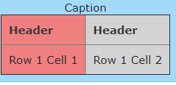
Table colgroup and col
<table border="1" cellpadding="10">
<caption>Caption</caption>
<colgroup>
<col style="background-color:lightcoral">
<col style="background-color:lightgray">
</colgroup>
<tr>
<th>Header</th><th>Header</th>
</tr>
<tr>
<td >Row 1 Cell 1</td>
<td>Row 1 Cell 2</td></tr>
</table>

Slide 89
HTML <colgroup> Tag
The <colgroup> tag specifies a group of one or more columns in a table for formatting.
The <colgroup> tag is useful for applying styles to entire columns, instead of repeating the styles for each cell, for each row.
Note: The <colgroup> tag must be a child of a <table> element, after any <caption> elements and before any <thead>, <tbody>, <tfoot>, and <tr> elements.
Tip: To define different properties to a column within a <colgroup>, use the <col> tag within the <colgroup> tag.

Slide 90
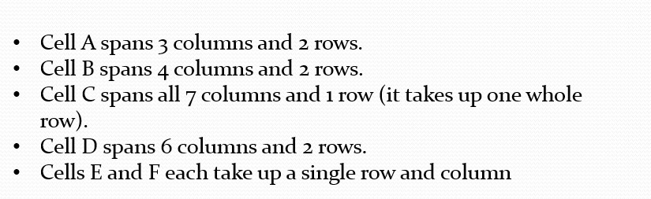
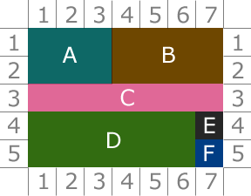
Activity

Slide 91
List
HTML can have three types of lists:
<ul>- Unordered list
<ol>- Ordered list
<dl>- Definition list.

Slide 92
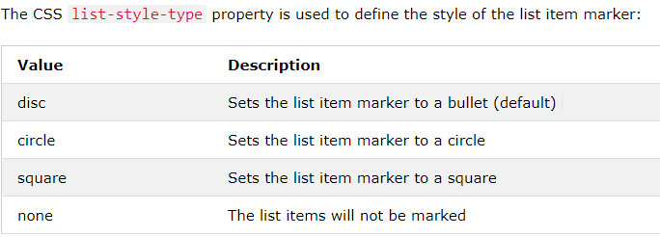
Unordered list
<ul style="list-style-type:disc;">
<li>Coffee</li>
<li>Tea</li>
<li>Milk</li>
</ul>

Slide 93
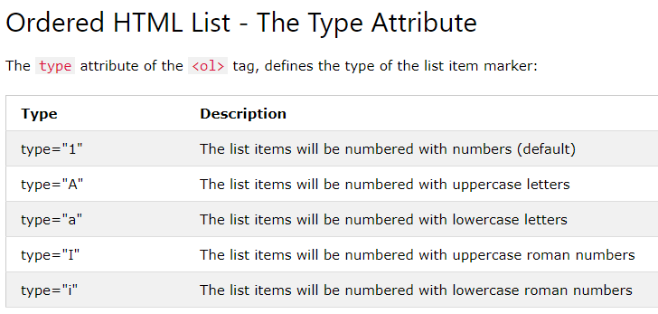
<ol type="1">
<li>Coffee</li>
<li>Tea</li>
<li>Milk</li>
</ol>

Slide 94
HTML - Definition list
A definition list start with the<dl> tag.
The <dt>tag defines the term (name).
the <dd> tag defines the data (definition or description).
<dl>
<dt>Coffee</dt>
<dd>- black hot drink</dd>
<dt>Milk</dt>
<dd>- white cold drink</dd>
</dl>

Slide 95
Nested HTML Lists
<!DOCTYPE html>
<html>
<body>
<h2>A Nested List</h2>
<p>List can be nested (lists inside lists):</p>
<ol>
<li>Coffee</li>
<li>Tea
<ul>
<li>Black tea</li>
<li>Green tea</li>
</ul>
</li>
<li>Milk</li>
</ol>
</body>
</html>

Slide 96
Control List Counting
<ol start="50">
<li>Coffee</li>
<li>Tea</li>
<li>Milk</li>
</ol>
<ol type="I" start="50">
<li>Coffee</li>
<li>Tea</li>
<li>Milk</li>
</ol>

Slide 97
HTML Block and Inline Elements
A block-level element always starts on a new line and takes up the full width available (stretches out to the left and right as far as it can).
<div>Hello</div> <div>World</div>
An inline element does not start on a new line and only takes up as much width as necessary.
<span>Hello</span> <span>World</span>
When used together with CSS, the <div> element can be used to style blocks of content:

Slide 98
Iframe
An iframe is used to display a web page within a web page. Syntax :
<iframe src="URL"></iframe>
Set Height and Width
<iframe src="demo_iframe.htm" height="200" width="300"></iframe>
<iframe src="demo_iframe.htm" style="height:200px;width:300px;"></iframe>

Slide 99
Iframe Border
By default, an iframe has a border around it.
To remove the border, add the style attribute and use the CSS border property
<iframe src="demo_iframe.htm" style="border:none;"></iframe>
<iframe src="demo_iframe.htm" style="border:2px solid red;"></iframe>

Slide 100
Iframe - Target for a Link
<!DOCTYPE html>
<html>
<body>
<h2>Iframe - Target for a Link</h2>
<iframe height="300px" width="100%" src=" " name="iframe_a"></iframe>
<p><a href="https://www.blacksheepcreative.co.nz" target="iframe_a">Blacksheep</a></p>
<p>When the target of a link matches the name of an iframe, the link will open in the iframe.</p>
</body>
</html>

Slide 101
Read and Practice Layout
https://www.w3schools.com/html/html_layout.asp

Slide 102
Form
A web form has two parts: the HTML ‘front end’ and a back end form processor.
The HTML front end part handles the presentation while the back end handles the form submissions (like saving the form submissions, sending emails etc).
The back end form processor script is usually written in languages like PHP, ASP or Perl

Slide 103
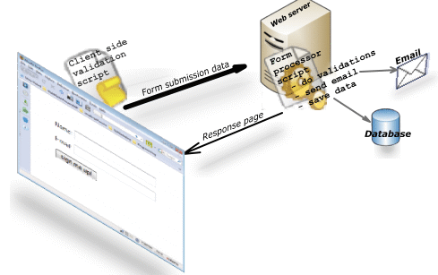
A visitor visits a web page that contains a form.
The web browser displays the HTML form.
The visitor fills in the form and submits
The browser sends the submitted form data to the web server
A form processor script running on the web server processes the form data
A response page is sent back to the browser.

Slide 104
https://www.youtube.com/watch?v=QqfTOZ1Tgb4&feature=youtu.be

Slide 105
The <form> Element
The HTML <form> element defines a form that is used to collect user input:
<form> . form elements . </form>

Slide 106
The Name Attribute
Each input field must have a name attribute to be submitted.
If the name attribute is omitted, the data of that input field will not be sent at all.
This example will only submit the "Last name" input field:
Example
<form action="/action_page.php"> First name:<br> <input type="text" value="Mickey"><br> Last name:<br> <input type="text" name="lastname" value="Mouse"><br><br> <input type="submit" value="Submit"> </form>

Slide 107
The input element
Text Input Controls
Checkboxes Controls
Radio Box Controls
Select Box Controls
File Select boxes
Hidden Controls
Clickable Buttons
Submit and Reset Button

Slide 108
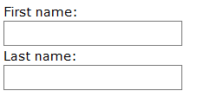
<!DOCTYPE html>
<html>
<body>
<h2>Text Input</h2>
<form>
First name:<br>
<input type="text" name="firstname">
<br>
Last name:<br>
<input type="text" name="lastname">
</form>
<p>Note that the form itself is not visible.</p>
<p>Also note that the default width of a text input field is 20 characters.</p>
</body>
</html>

Slide 109
Text Input Controls
There are three types of text input used on forms −
Single-line text input controls − This control is used for items that require only one line of user input, such as search boxes or names. They are created using HTML <input> tag.
First name: <input type = "text" name = "first_name" />

Slide 110
Password input controls − This is also a single-line text input but it masks the character as soon as a user enters it. They are also created using HTMl <input> tag.
Password: <input type = "password" name = "password" />

Slide 111
Multi-line text input controls − This is used when the user is required to give details that may be longer than a single sentence. Multi-line input controls are created using HTML <textarea> tag
<form>
Description :
<br />
<textarea rows = "5" cols = "50" name = "description"> Enter description here...
</textarea>
</form>

Slide 112
Checkbox Control
Checkboxes are used when more than one option is required to be selected. They are also created using HTML <input> tag but type attribute is set to checkbox..
<form>
<input type = "checkbox" name = "maths" value = "on"> Maths<br>
<input type = "checkbox" name = "physics" value = "on"> Physics<br>
</form>

Slide 113

Select Box Control
A select box, also called drop down box which provides option to list down various options in the form of drop down list, from where a user can select one or more options.

Slide 114
<!DOCTYPE html>
<html>
<head>
<title>
Select Box Control
</title>
</head>
<body>
<form>
<select name = "dropdown">
<option value = "Maths" selected>Maths</option>
<option value = "Physics">Physics</option>
</select>
</form>
</body>
</html>

Slide 115
Radio Button Input
<input type="radio"> defines a radio button.
Radio buttons let a user select ONE of a limited number of choices:
Example
<form> <input type="radio" name="gender" value="male" checked> Male<br> <input type="radio" name="gender" value="female"> Female<br> <input type="radio" name="gender" value="other"> Other </form>

Slide 116

File Upload Box
If you want to allow a user to upload a file to your web site, you will need to use a file upload box, also known as a file select box. This is also created using the <input> element but type attribute is set to file.
input accept="file_extension|audio/*|video/*|image/*|media_type">

Slide 117
<!DOCTYPE html>
<html>
<head>
<title>
File Upload Box
</title>
</head>
<body>
<form> <input type = "file" name = "fileupload" accept = "image/*" /> </form>
</body>
</html

Slide 118
Button Controls
There are various ways in HTML to create clickable buttons. You can also create a clickable button using <input>tag by setting its type attribute to button. The type attribute can take the following values −.
Sr.No | Type & Description
1 | submit This creates a button that automatically submits a form.
2 | reset This creates a button that automatically resets form controls to their initial values.
3 | button This creates a button that is used to trigger a client-side script when the user clicks that button.
4 | image This creates a clickable button but we can use an image as background of the button.

Slide 119

<!DOCTYPE html>
<html>
<head>
<title>File Upload Box</title>
</head>
<body>
<form>
<input type = "submit" name = "submit" value = "Submit" />
<input type = "reset" name = "reset" value = "Reset" />
<input type = "button" name = "ok" value = "OK" />
<input type = "image" name = "imagebutton" src = "https://cdn-blog.adafruit.com/uploads/2012/12/html4.jpeg" Style="width:50px; height:50px" />
</form>
</body>
</html>

Slide 120
The Submit Button
<input type="submit"> defines a button for submitting the form data to a form-handler.
The form-handler is typically a server page with a script for processing input data.
The form-handler is specified in the form's action attribute:
Example
<form action="/action_page.php"> First name:<br> <input type="text" name="firstname" value="Mickey"><br> Last name:<br> <input type="text" name="lastname" value="Mouse"><br><br> <input type="submit" value="Submit"> </form>

Slide 121
The action attribute
The action attribute defines the action to be performed when the form is submitted.
Normally, the form data is sent to a web page on the server when the user clicks on the submit button.
In the example above, the form data is sent to a page on the server called "/action_page.php". This page contains a server-side script that handles the form data:
<form action="/action_page.php">

Slide 122
<!DOCTYPE html>
<html>
<body>
<h2>HTML Forms</h2>
<form action="/action_page.php">
First name:<br>
<input type="text" name="firstname" value="Mickey">
<br>
Last name:<br>
<input type="text" name="lastname" value="Mouse">
<br><br>
<input type="submit" value="Submit">
</form>
<p>If you click the "Submit" button, the form-data will be sent to a page called "/action_page.php".</p>
</body>
</html>

Slide 123
The Target Attribute
The target attribute specifies if the submitted result will open in a new browser tab, a frame, or in the current window.
The default value is "_self" which means the form will be submitted in the current window.
To make the form result open in a new browser tab, use the value "_blank":
<form action="/action_page.php" target="_blank">

Slide 124
The Method Attribute
The method attribute specifies the HTTP method (GET or POST) to be used when submitting the form data:
<form action="/action_page.php" method="get">
<form action="/action_page.php" method="post">

Slide 125
When to Use GET?
The default method when submitting form data is GET.
However, when GET is used, the submitted form data will be visible in the page address field:
/action_page.php?firstname=Mickey&lastname=Mouse
Notes on GET:
Appends form-data into the URL in name/value pairs
The length of a URL is limited (about 3000 characters)
Never use GET to send sensitive data! (will be visible in the URL)
Useful for form submissions where a user wants to bookmark the result
GET is better for non-secure data, like query strings in Google

Slide 126
When to Use POST?
Always use POST if the form data contains sensitive or personal information. The POST method does not display the submitted form data in the page address field.
Notes on POST:
POST has no size limitations, and can be used to send large amounts of data.
Form submissions with POST cannot be bookmarked

Slide 127
https://www.telerik.com/fiddler/web-traffic-recording

Slide 128
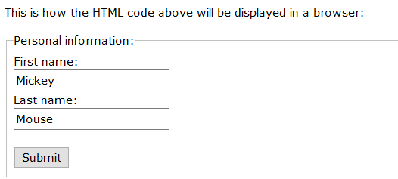
Grouping Form Data with <fieldset>
The <fieldset> element is used to group related data in a form.
The <legend> element defines a caption for the <fieldset> element.
Example
<form action="/action_page.php"> <fieldset> <legend>Personal information:</legend> First name:<br> <input type="text" name="firstname" value="Mickey"><br> Last name:<br> <input type="text" name="lastname" value="Mouse"><br><br> <input type="submit" value="Submit"> </fieldset> </form>

Slide 129

<!DOCTYPE html>
<html>
<body>
<h2>Date Field</h2>
<p>The <strong>input type="date"</strong> is used for input fields that should contain a date.</p>
<p>Depending on browser support:<br>A date picker can pop-up when you enter the input field.<p>
<form action="/action_page.php">
Birthday:
<input type="date" name="bday">
<input type="submit">
</form>
<p><strong>Note:</strong> type="date" is not supported in Safari or Internet Explorer 11 and earlier versions.</p>
</body>
</html>

Slide 130

<!DOCTYPE html>
<html>
<body>
<h2>Color Picker</h2>
<p>The <strong>input type="color"</strong> is used for input fields that should contain a color.</p>
<p>Depending on browser support:<br>A color picker can pop-up when you enter the input field.</p>
<form action="/action_page.php">
Select your favorite color:
<input type="color" name="favcolor" value="#ff0000">
<input type="submit">
</form>
<p><b>Note:</b> type="color" is not supported in Internet Explorer 11 and earlier versions or Safari 9.1 and earlier versions.</p>
</body>
</html>

Slide 131
Discussion and Reading
https://24ways.org/2009/have-a-field-day-with-html5-forms
Read the HTML Media
https://www.w3schools.com/html/html_media.asp
Revise the HTML thoroughly

Slide 132
Activity
Embed a Google Map in your webpage.
Design a one form of your choice which must have the following:
Text Input Controls
Checkboxes Controls
Radio Box Controls
Select Box Controls
File Select boxes
Hidden Controls
Clickable Buttons- Submit, Reset Button and Clickable Image.

